Slide 1

Differentials Applied Part 2
RCET 0264 Introductory Calculus
Tim Leishman

Slide 2
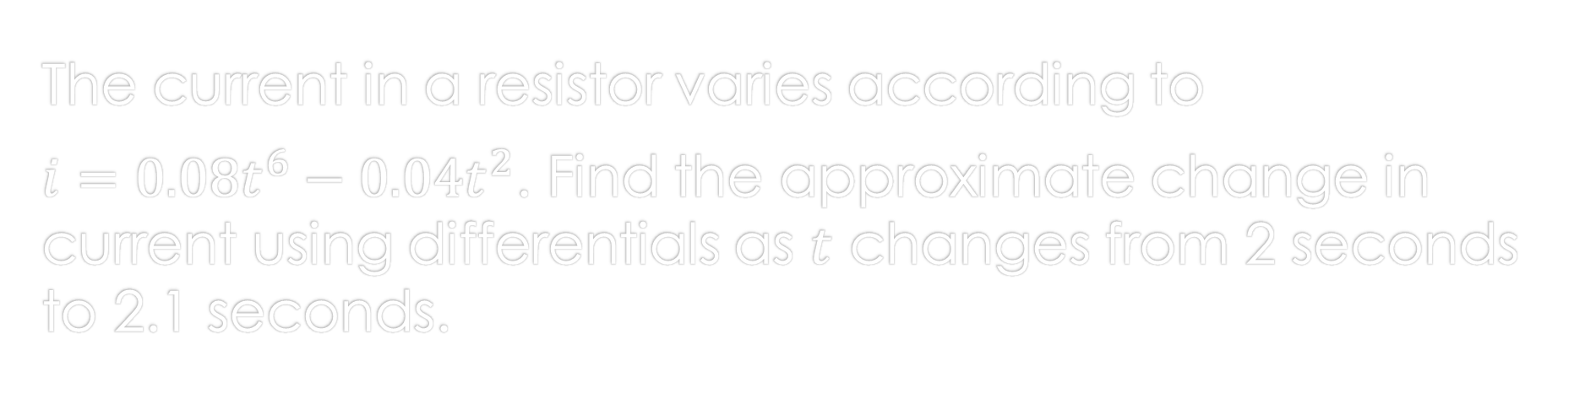
differentials
The current in a resistor varies according to
$i=0.08t^{6}−0.04t^{2}$. Find the approximate change in current using differentials as $t$ changes from 2 seconds to 2.1 seconds.

Slide 3


differentials
The current in a resistor varies according to$i=0.08t^{6}−0.04t^{2}$. Find the approximate change in current using differentials as $t$ changes from 2 seconds to 2.1 seconds.
$i=0.08t^{6}−0.04t^{2}$
$\frac{di}{dt}=0.48t^{5}−0.08t$
$di=\left(0.48t^{5}−0.08t\right)dt$
$di=\left(0.48(2^{5})−0.08(2\right))0.1$
$di=(\left(15.36)−(0.160\right))0.1$
$di=(15.2)0.1$
$di=1.52 amps$

Slide 4
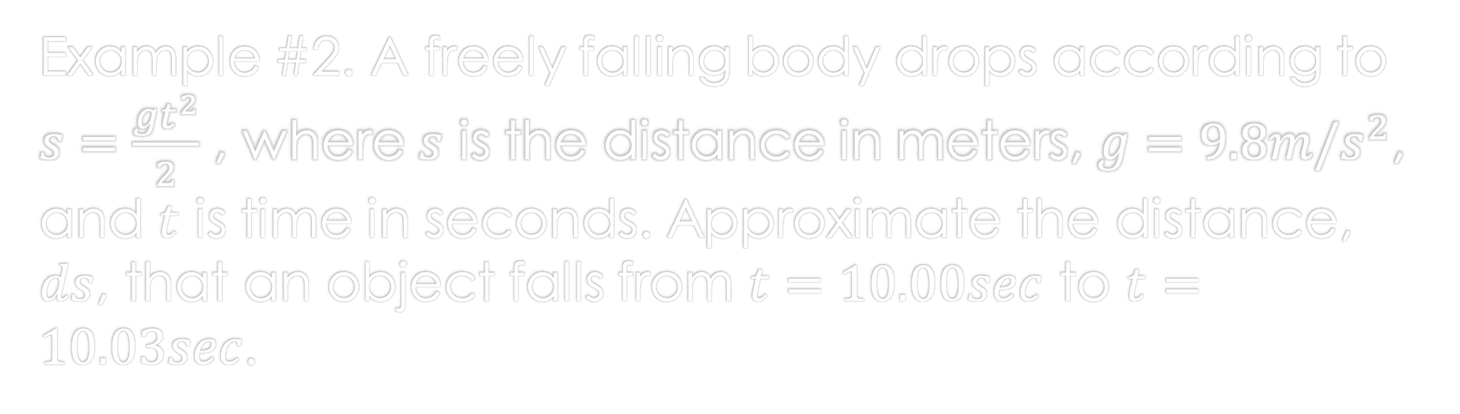
differentials
Example #2. A freely falling body drops according to $s=\frac{gt^{2}}{2}$ , where $s$ is the distance in meters, $g=9.8m/s^{2}$, and $t$ is time in seconds. Approximate the distance, $ds$, that an object falls from $t=10.00sec$ to $t=10.03sec$.

Slide 5

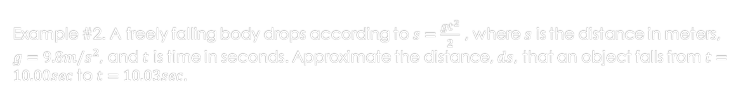
differentials
Example #2. A freely falling body drops according to $s=\frac{gt^{2}}{2}$ , where $s$ is the distance in meters, $g=9.8m/s^{2}$, and $t$ is time in seconds. Approximate the distance, $ds$, that an object falls from $t=10.00sec$ to $t=10.03sec$.
$s=\frac{gt^{2}}{2}$
$s=\frac{1}{2}gt^{2}$
$\frac{ds}{dt}=gt$
$ds=gt(dt)$
$ds=9.8(t)(dt)$
$ds=9.8\left(10\right)(0.03)$
$ds=2.94m$

Slide 6
References:
Ewen, D., Gary, J. S., & Trefzger, J. E. (2005). Technical calculus. Upper Saddle River, NJ: Pearson/Prentice Hall.
https://www.desmos.com
https://www.autodesk.com/products/fusion-360/overview

